Slide 1
Introduction to relational databases

Slide 2
Why do we need DBs
Volume of information in nowadays world is increasing dramatically. This information has to be processed, saved and used.
Almost every application and service operates with databases in one or another manner .
Basic knowledge and experience with RDBMS – mandatory requirement for developers, despite their main specialization (Java, Python etc)
Some career options tied to DBs:
Business/Data Analyst
Business Intelligence (BI) developer
Database/Data Engineer
Data Science developer

Slide 3
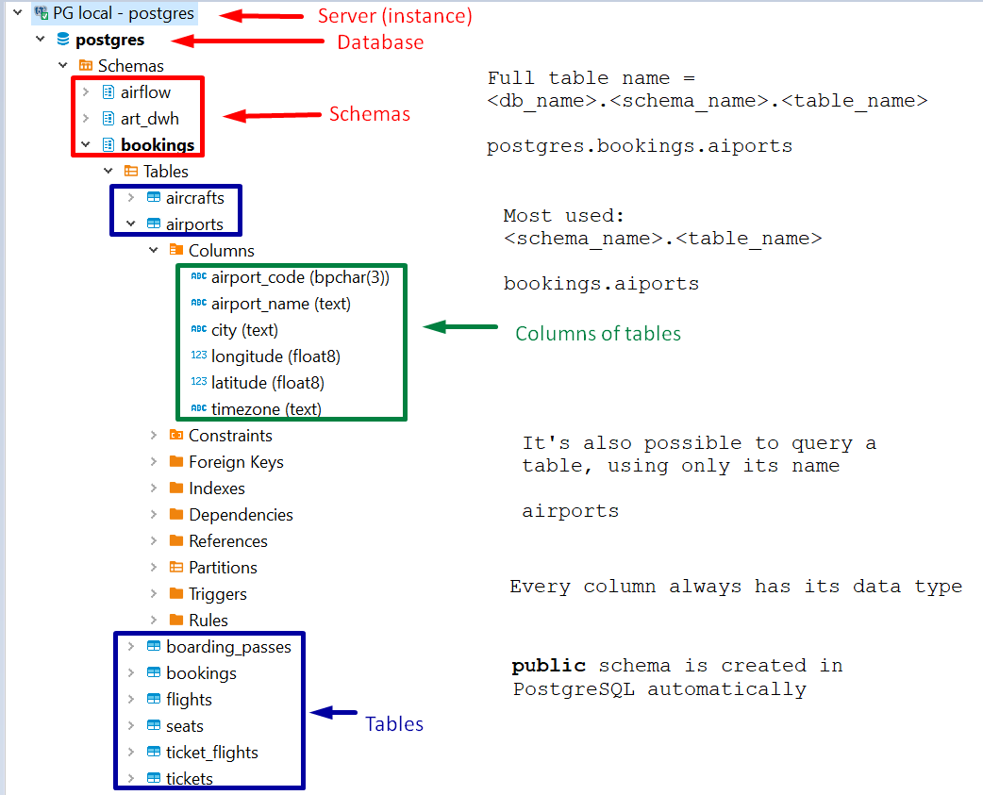
DB objects

Slide 4
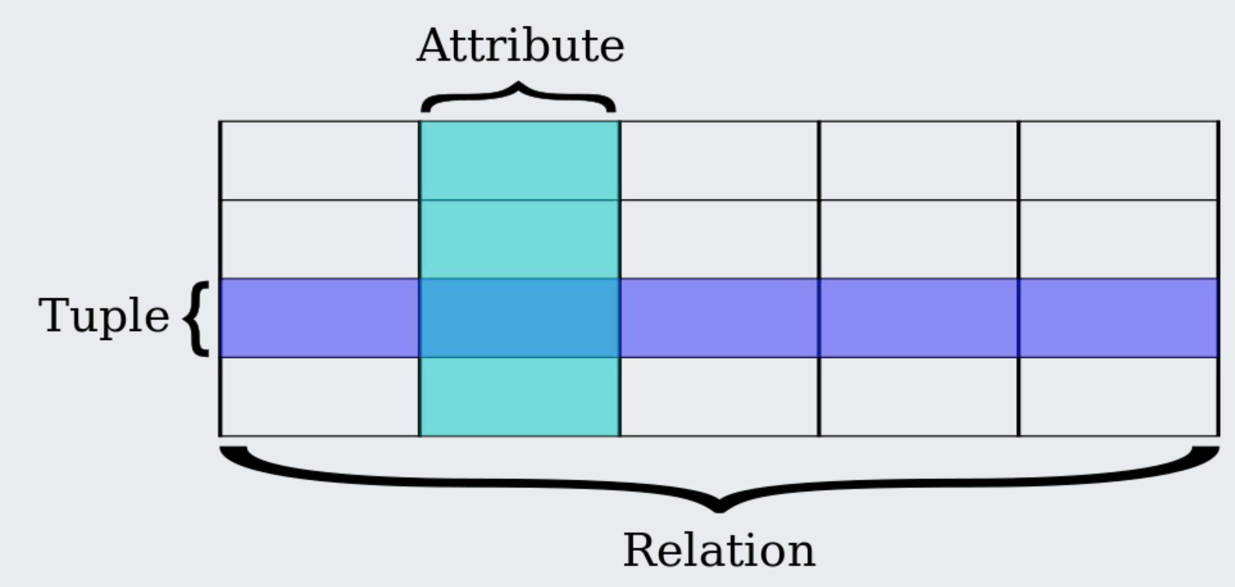
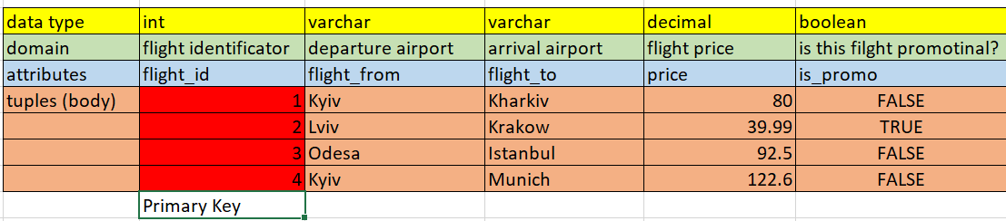
Table structure

Slide 5
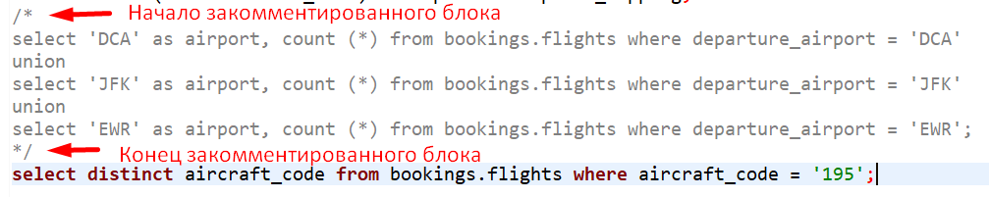
SQL
SQL (Structured Query Language) – main language for databases
It allows to work with data and with database management systems as well: create tables, manage access permissions etc.
There’re the common standard (ANSI SQL) and specific DB-related dialects
Usually SQL keywords are CAPITALIZED. It’s not necessary, but improves readability.
Every statement has to end with ; (semicolon):
SELECT airport_name FROM bookings.airports
WHERE city = 'New York'; --list of NY airports
Comments you want to put on single line start with -- (two dashes), see above
You can comment an entire block of code with /* и */

Slide 6
Basic table operations: CREATE, DROP, ALTER
Create a table
CREATE TABLE public.my_table -- table creation
(airport_name text NOT NULL,-- name of the column and its data type, optionally – addition properties like NOT NULL
airport_class integer,
is_military boolean,
…
);
Delete a table
DROP TABLE [IF EXISTS] public.my_table [CASCADE];
IF EXISTS – check if table exists. If it doesn’t, prevents the error.
CASCADE – also deletes all dependent objects
Changing (altering) a table
ALTER TABLE public.my_table RENAME TO my_new_table; -- rename a table
ALTER TABLE public.my_new_table ADD [COLUMN] column99 decimal; --add a column to a table
ALTER TABLE public.my_new_table RENAME [COLUMN] column99 TO column999; -- rename a column
ALTER TABLE public.my_new_table DROP [COLUMN] column99; -- delete a column from a table

Slide 7
Basic data operations: INSERT, SELECT, DELETE
Insert a data
INSERT INTO <table_name> (<columns_list>) VALUES (<value1, value2,…valueN>);
INSERT INTO public.my_new_table (airport_name, airport_class, is_military)
VALUES ('Kyiv Boryspil', 1, FALSE);
Select (obtain) a data
SELECT <columns_list> FROM <table_name> WHERE <condition>;
SELECT airport_name from public.my_new_table WHERE airport_class = 1;
SELECT * FROM public.my_new_table WHERE airport_class = 1;
* - selects data from all columns
Delete a data
DELETE FROM <table_name> WHERE <condition>;
DELETE FROM public.my_new_table WHERE airport_class = 1;
!!!DELETE without condition will delete ALL data from a table

Slide 8
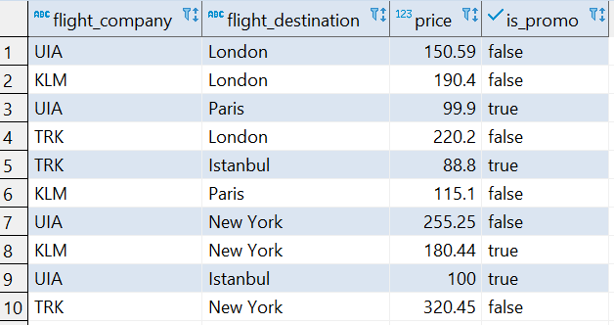
SELECT basics: WHERE, aliases
Let’s prepare some data:
create table public.boryspil_flights (id int, flight_company text, flight_destination text, price decimal, is_promo boolean);
insert into public.boryspil_flights values (4, 'UIA', 'London', 150.59, false), (2, 'KLM', 'London', 190.4, false),
(3, 'UIA', 'Paris', 99.9, true), (1, 'TRK', 'London', 220.20, false), (8, 'TRK', 'Istanbul', 88.80, true),
(6, 'KLM', 'Paris', 115.10, false), (10, 'UIA', 'New York', 255.25, false), (5, 'KLM', 'New York', 180.44, true),
(9, 'UIA', 'Istanbul', 100.0, true), (7, 'TRK', 'New York', 320.45, false);
WHERE – condition to filter data in the output
SELECT * FROM public.boryspil_flights WHERE flight_company = 'UIA'; -- all UIA company flights
SELECT * FROM public.boryspil_flights WHERE flight_company = 'UIA' AND price > 100; -- all UIA flights with price > 100
SELECT * FROM public.boryspil_flights WHERE flight_company = 'TRK' AND NOT (flight_destination = 'Istanbul'); -- all TRK flights, but not to Istanbul
SELECT * FROM public.boryspil_flights WHERE flight_company = 'TRK' AND flight_destination != 'Istanbul'; -- same as previous
SELECT * FROM public.boryspil_flights WHERE (flight_company IN ('KLM', 'UIA') AND is_promo = false) AND price < 150;
SELECT * FROM public.boryspil_flights WHERE price BETWEEN 100 AND 200; -- all flights with price between 100 and 200
Aliases
Use them to name a calculated columns or rename existing columns in the output. In many cases using aliases for calculated columns is mandatory.
SELECT <column_name or calculation> AS <alias_name>
SELECT flight_company AS tax_payer, (price * 0.2) AS VAT FROM public.boryspil_flights WHERE flight_destination = 'New York'; -- VAT value for each company fliying to New York.
VAT here – is the name for new, calculated column we’re getting in the output.

Slide 9
SELECT basics: DISTINCT, ORDER BY
DISTINCT
Allows to select only distinct (unique) values, eliminating duplicates. Let’s compare results of 2 queries:
select flight_company from public.boryspil_flights; -- here we’ve got all, with duplicates, records for flight companies;
select distinct flight_company from public.boryspil_flights; -- here we’ve got only unique values, and correctly answered the question “What flight companies operate in Boryspil?”
ORDER BY <columns_list> [ASC|DESC]
Defines how data is sorted in query output. Data can be sorted by one or many columns, in one or many directions.
ASC – ascending, DESC – descending.
SELECT * FROM public.boryspil_flights ORDER BY price; -- outputs the table, sorted by price, ascending (by default)
SELECT * FROM public.boryspil_flights ORDER BY price DESC; -- sorted by price, from high to low (descending)
SELECT * FROM public.boryspil_flights ORDER BY flight_company ASC, price DESC; -- sorted by companies alphabetically, and on price in reverse descending
SELECT * FROM public.boryspil_flights ORDER BY 2,1 -- sorted by #s of columns in the output. It’s worth to use only for calculated columns, otherwise – use column name
SELECT flight_company, (price * 0.2) as VAT from public.boryspil_flights WHERE flight_destination = 'New York' ORDER BY 2 desc;

Slide 10
SELECT basics: LIMIT, OFFSET
LIMIT
Limits the query output to specified number of rows.
SELECT * FROM public.boryspil_flights LIMIT 5; -- outputs first 5 (random!) rows from the table
SELECT * FROM public.boryspil_flights ORDER BY price DESC LIMIT 5; -- outputs first 5 rows sorted by price DESC
SELECT * FROM public.boryspil_flights WHERE flight_company = 'TRK' ORDER BY price DESC LIMIT 2; -- outputs 2 most expensive flights by TRK
OFFSET
Allows you to output results starting from specific (in # of rows) position or skip N rows. OFFSET = 0 means no rows skipped.
SELECT * FROM public.boryspil_flights ORDER BY id OFFSET 5; -- we skip first 5 rows
SELECT * FROM public.boryspil_flights WHERE price > 100 ORDER BY price OFFSET 2; -- outputs flights costing >100, skipping first 2 cheapest

Slide 11
Q&A / Homework
Доповнення до домашнього завдання про дати, що не встиглося на лекції (але також дещо з цього ви можете почитати у документації по лінкам у презі).
Тип даних для дат - date
(самий загальний і простий, ми ще встигнемо зачепити більш складніші)
Тобто, створюючи таблицю с колонками типу "дата" пишіть:
create table if not exists public.my_good_table
(date_column date, text_column text);
Вставляти дату треба у форматі YYYY-MM-DD, виділяючи її апострофами як текст:
insert into public.my_good_table (date_column, text_column) VALUES ('2020-01-01', 'January 1st 2020');
Порівнювати/Фильтрувати дати у (більш, менш, проміжок) треба як числа у WHERE:
SELECT * from public.my_good_table WHERE date_column < '2025-05-05';
SELECT * from public.my_good_table WHERE date_column BETWEEN '2010-05-05' and '2055-12-25';
це вам знадобиться для завдань накшталт
"Які продукти протухнуть у цьому році?"
Create a table in public schema with the following structure, and fill it with data provided
product_id | product_name | product_supplier | barcode | price | quantity | expiration_date
20 | H&S Shampoo | P&G | 4820004385257 | 128.5 | 50 | 2022-04-05
25 | Milka | Nestle | 4820004385256 | 41 | 2000 | 2021-07-06
15 | iPhone 11 64 GB | Apple | 4820004385255 | 22500 | 10 | 2024-10-07
80 | Varvar Stout | Varvar | 4820004385254 | 55 | 100 | 2021-10-08
77 | iPad Pro 128 GB | Apple | 4820004385253 | 20000 | 5 | 2024-01-09
64 | Morshinska 1.5L green | IDS | 4820004385250 | 13.5 | 240 | 2021-10-10
17 | Blend a med | P&G | 4820004385260 | 38 | 100 | 2021-06-11
44 | Varvar IPA | Varvar | 4820004385270 | 50 | 24 | 2021-10-12
56 | Q80T 55 inch TV | Samsung | 4820004385280 | 35000 | 5 | 2023-05-01
70 | Leleka Cabernet | Leleka Wines | 4820004385290 | 160 | 48 | 2022-02-01
output products:
- Ordered by price from high to low
- Only 5 products with closest exp. date
2) output all Apple products
3) output all products cost more than 100
4) delete all Varvar products
5) insert Varvar products again
6) output total cost for iPhone 11
7) output products which expire in 2021

Slide 12
Homework: what to read
https://habr.com/ru/company/yandex/blog/522164/ - (rus) great overview article about databases
https://www.pluralsight.com/guides/manipulating-data-using-insert-update-delete-sql-server – INSERT and DELETE basics
https://www.techonthenet.com/sql/select.php - SELECT basics
https://www.postgresql.org/docs/12/datatype.html - read about numeric, character, boolean and date types
(Russian version) https://postgrespro.ru/docs/postgresql/12/datatype
Simplified version:
https://www.prisma.io/dataguide/postgresql/introduction-to-data-types

